Slide 1
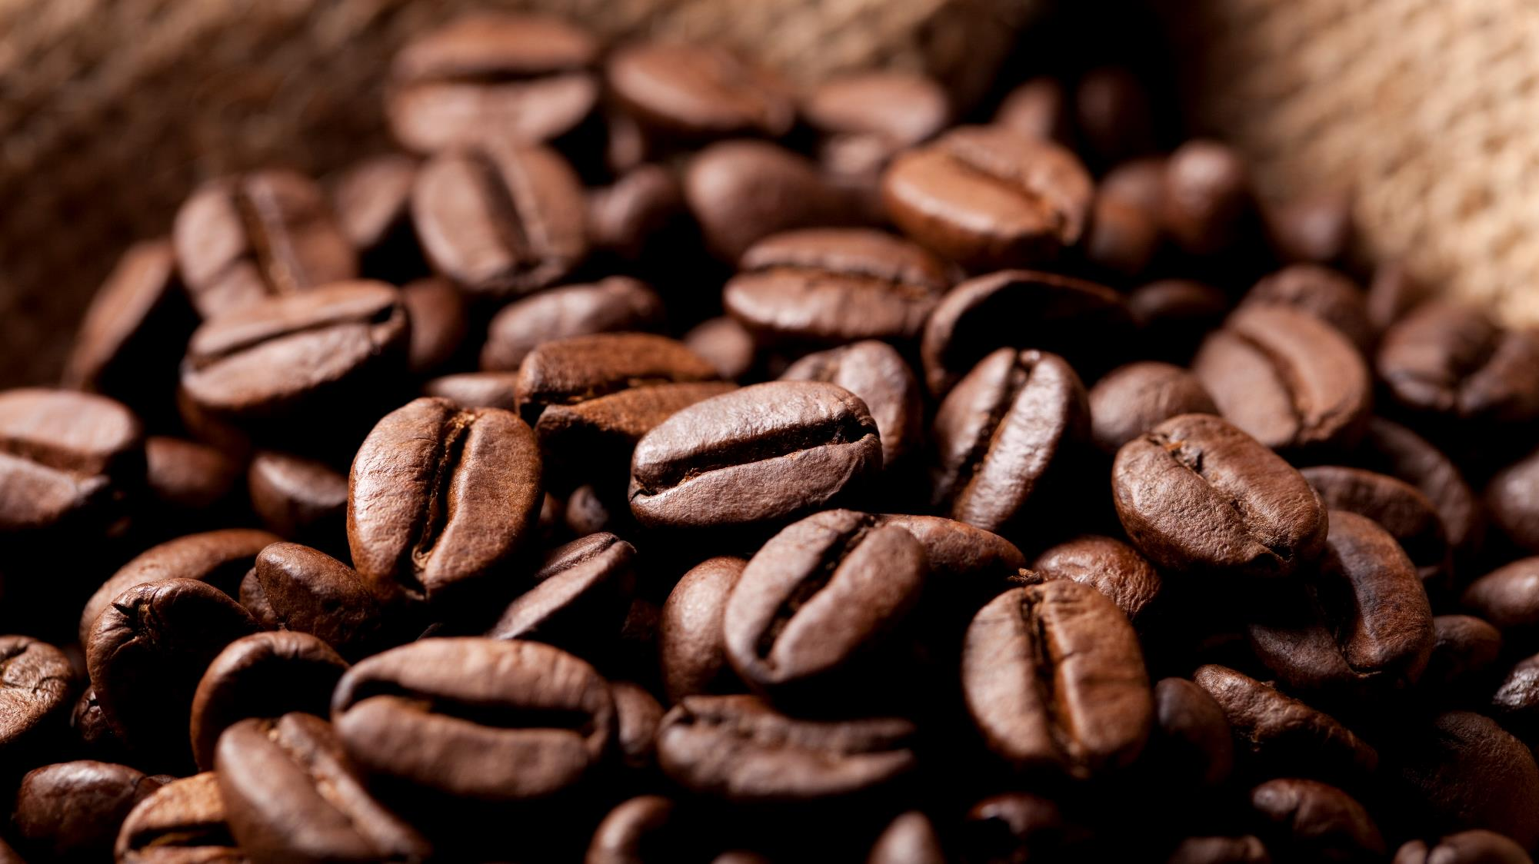
Coffee shop sales
Naga Pavan Kumar

Slide 2
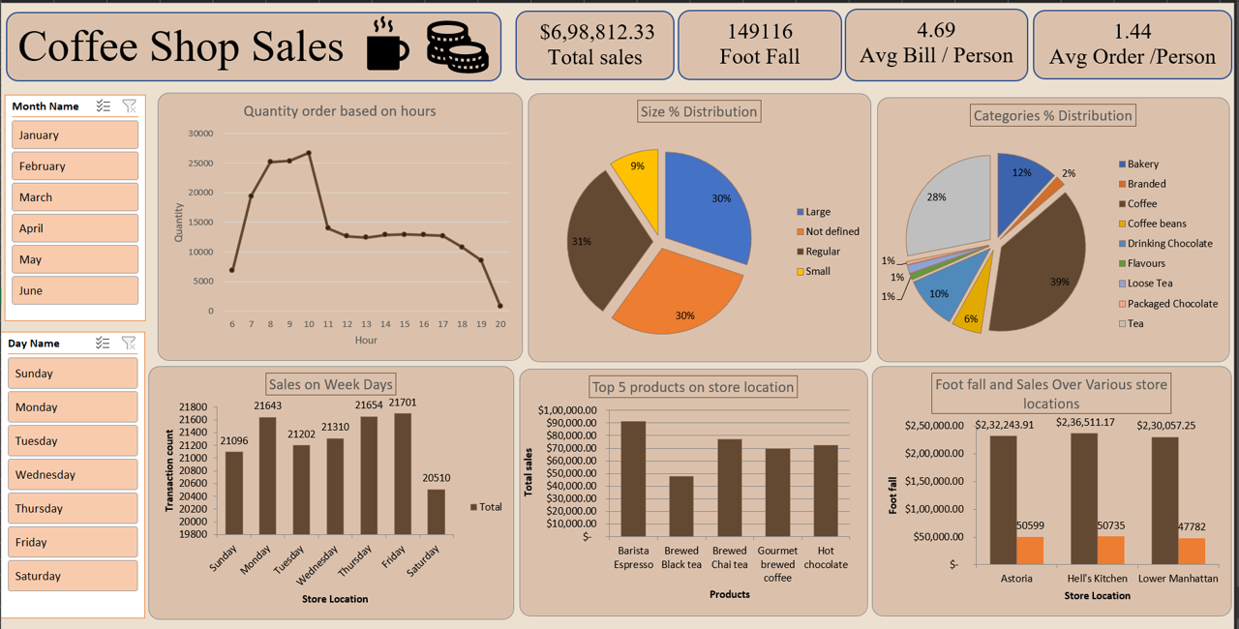

Slide 3

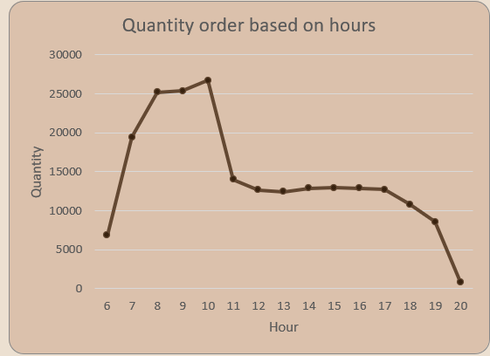
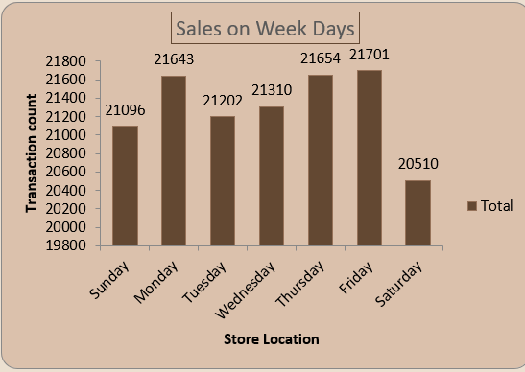
How do sales vary by day of the week and hour of the day?
Observed : Monday, Thursday, and Friday have higher order volumes,
while Saturday has fewer orders.
Observed: Sales are higher during the morning hours (7 AM to 10 AM)
and lower in the evening, especially at 8 PM
These two findings can be confirmed by the graphs provided.

Slide 4
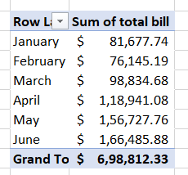

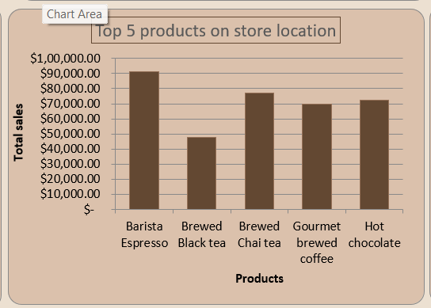
Are there any peak times for sales activity?
What is the total sales revenue for each month?
Peak sales were found in the May and June months with total sales of $156,727 and $166,485 respectively.
What is the average price/order per person?
Observed: The average price per order is $4.69
Which products are the best- selling in terms of quantity and revenue?
Observed: Brewed Chai tea, Gourmet brewed coffee, Barista Espresso, Brewed Black tea, and Hot chocolate are the top-selling products

Slide 5
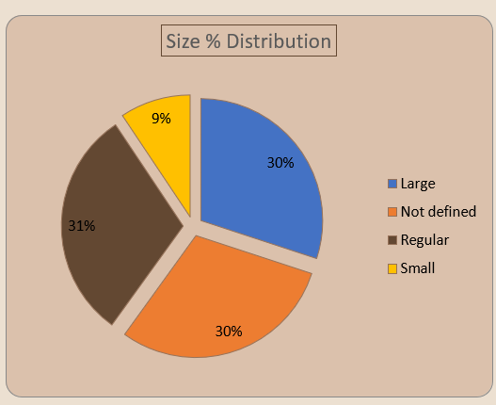
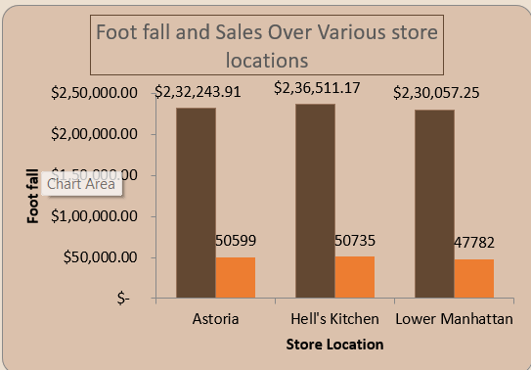
SIZE DISTRIBUTION BASED ON SALES
Observed : Large Size (34%), Not Defined (31%), Regular Size (28%), Small Size (7%).
How do sales vary across different store locations?
Finding: The Hell's Kitchen store has the highest sales ($236,511),
while the Lower Manhattan store has the lowest sales ($230,057).

Slide 6
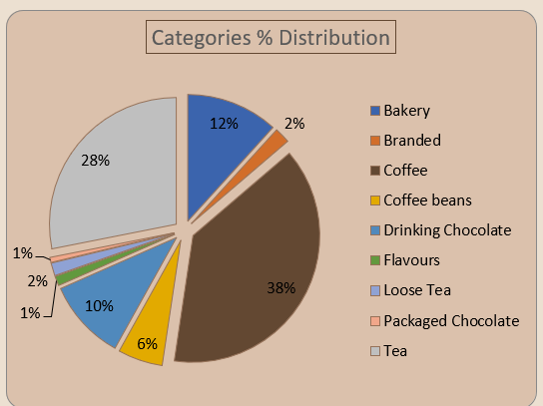
How do sales vary by product category and type?
Finding: Coffee accounts for 38% of total sales, Tea for 28%, and Bakery items for 12%. The Barista Espresso and Ethiopia products generate the highest sales.

Slide 7
Thank you

